Slide 1
Weapon-LLM
홍세연

Slide 2
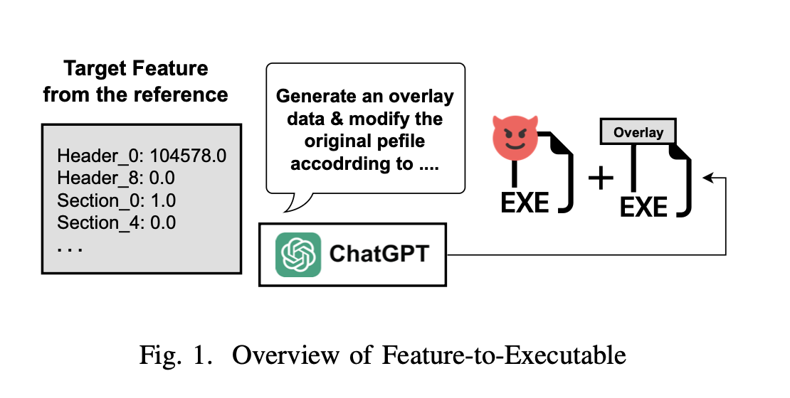
Adversarial Malware

Slide 3
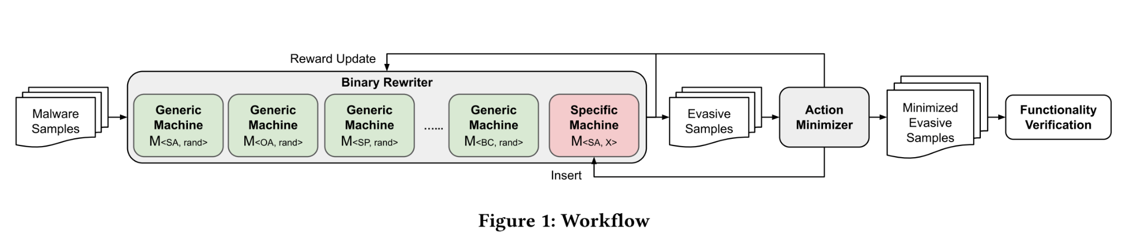
MAB-Malware
MAB-malware proposes a black-box Reinforcement Learning (RL) based framework to generate AEs for PE malware classifiers and AV engines.
Song, W., Li, X., Afroz, S., Garg, D., Kuznetsov, D., & Yin, H. (2022). MAB-Malware: A Reinforcement Learning Framework for Blackbox Generation of Adversarial Malware. ASIA CCS 2022 - Proceedings of the 2022 ACM Asia Conference on Computer and Communications Security, 990–1003. https://doi.org/10.1145/3488932.3497768

Slide 4
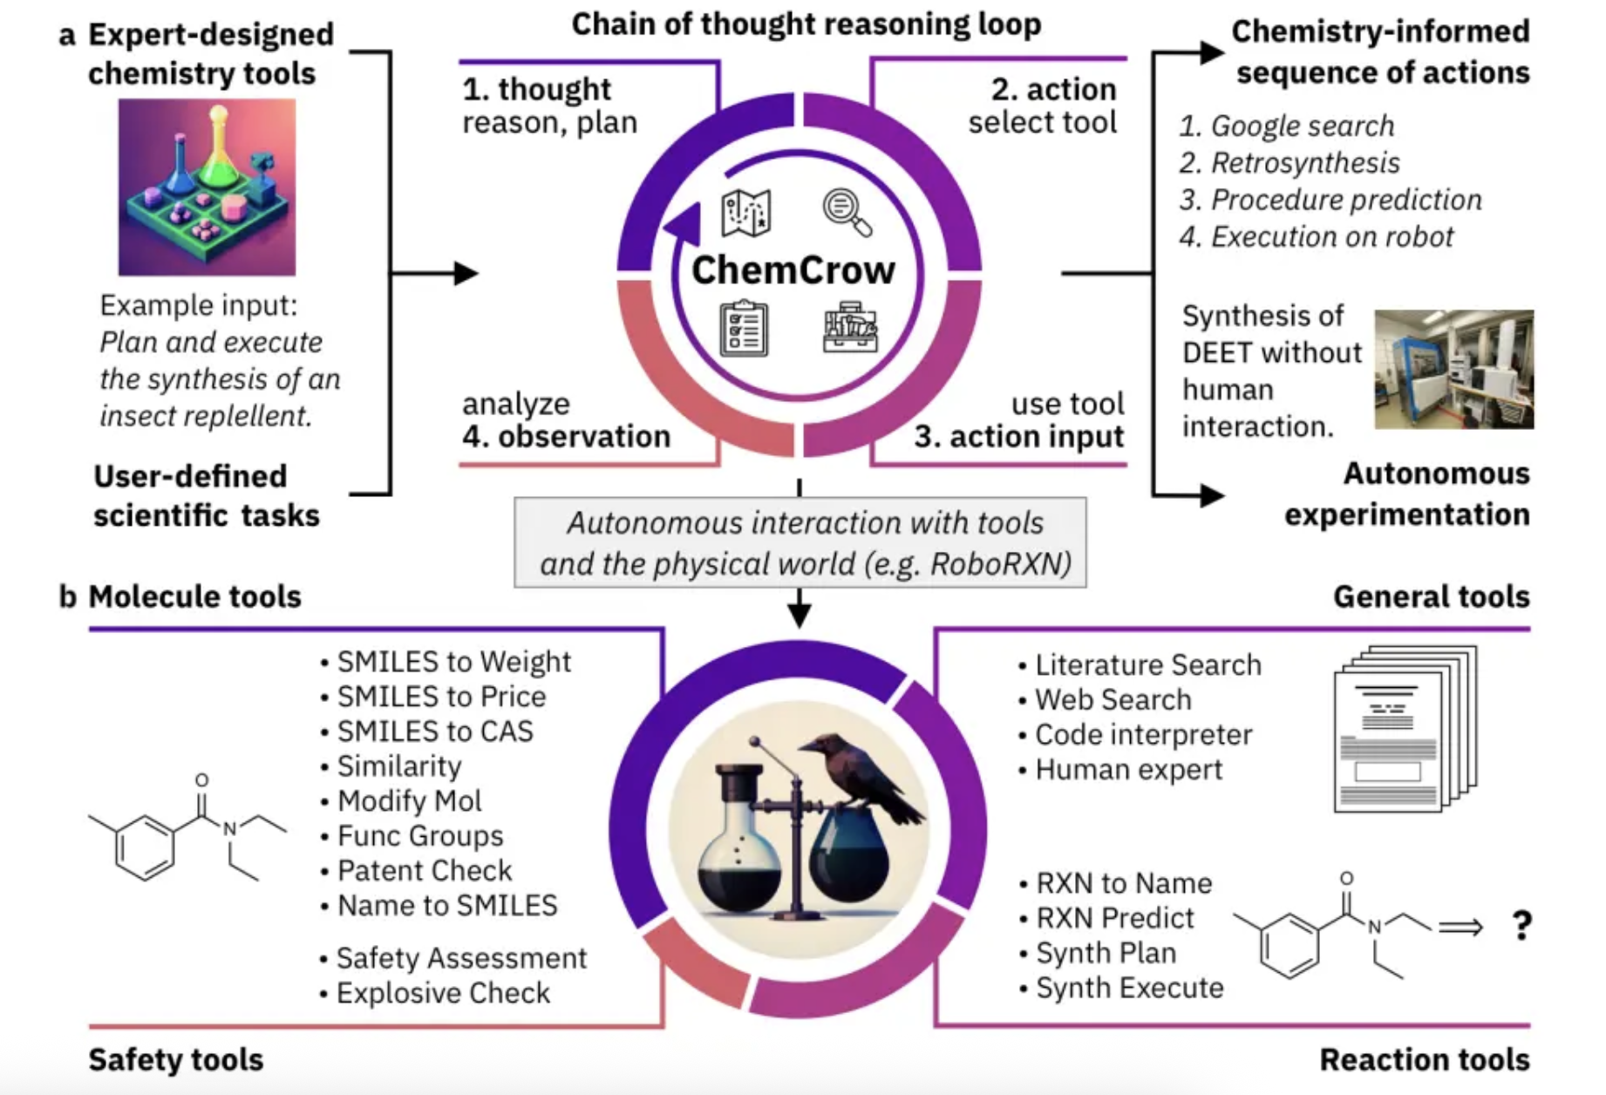
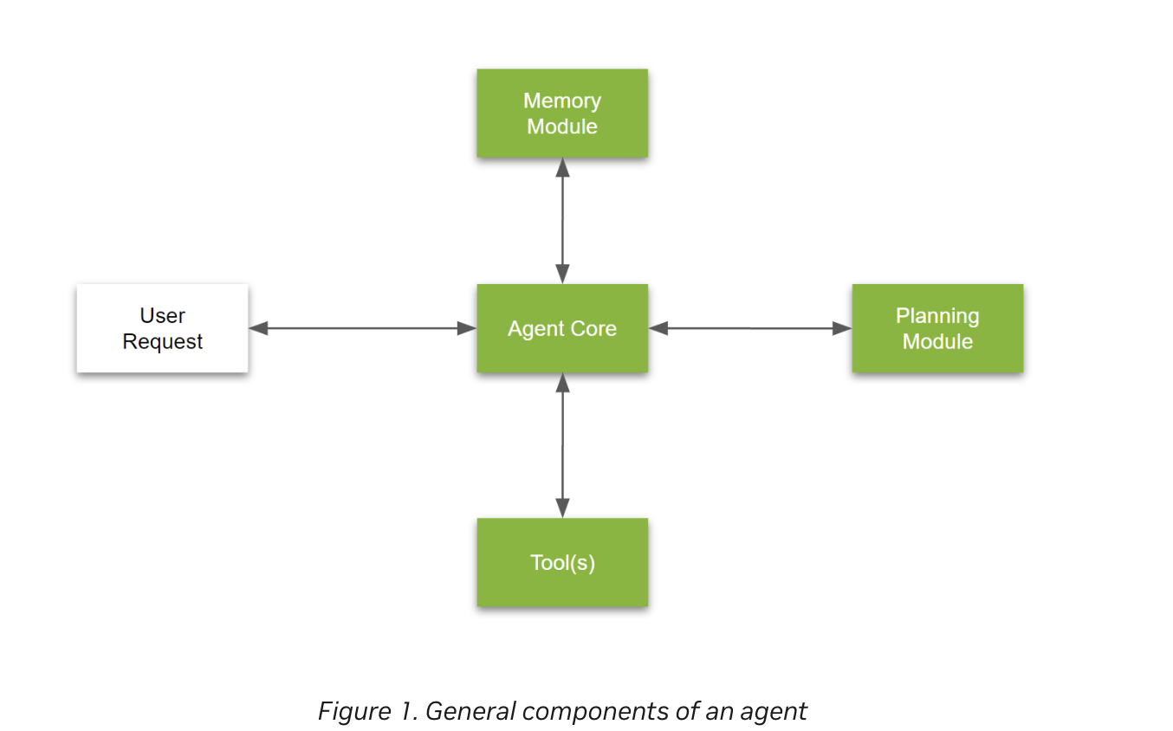
LLM Agent
LLM agents, which are LLMs equipped with additional tools to solve complicated problems.
https://developer.nvidia.com/blog/introduction-to-llm-agents/

Slide 5
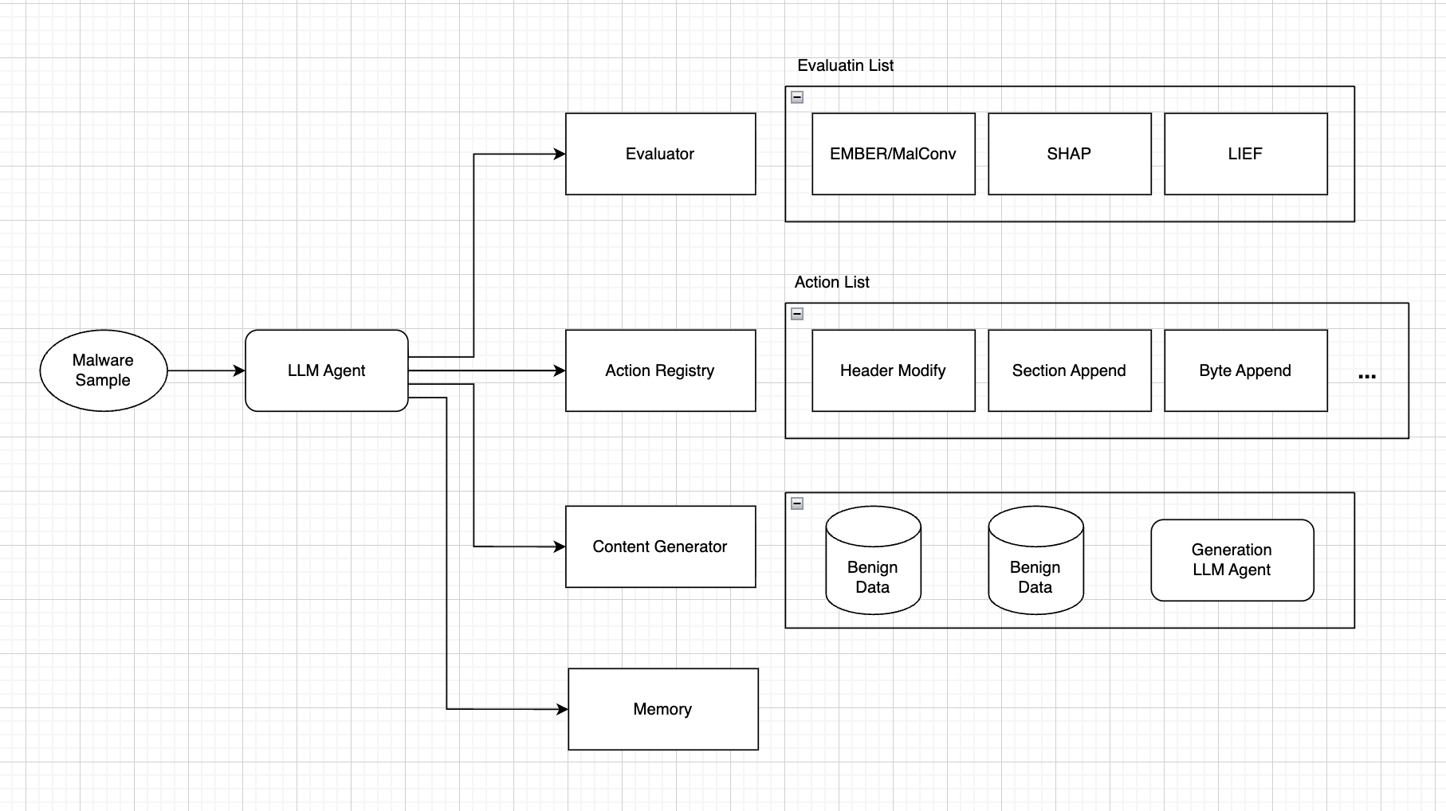
LLM Agent for Weapon LLM

